Slide 1
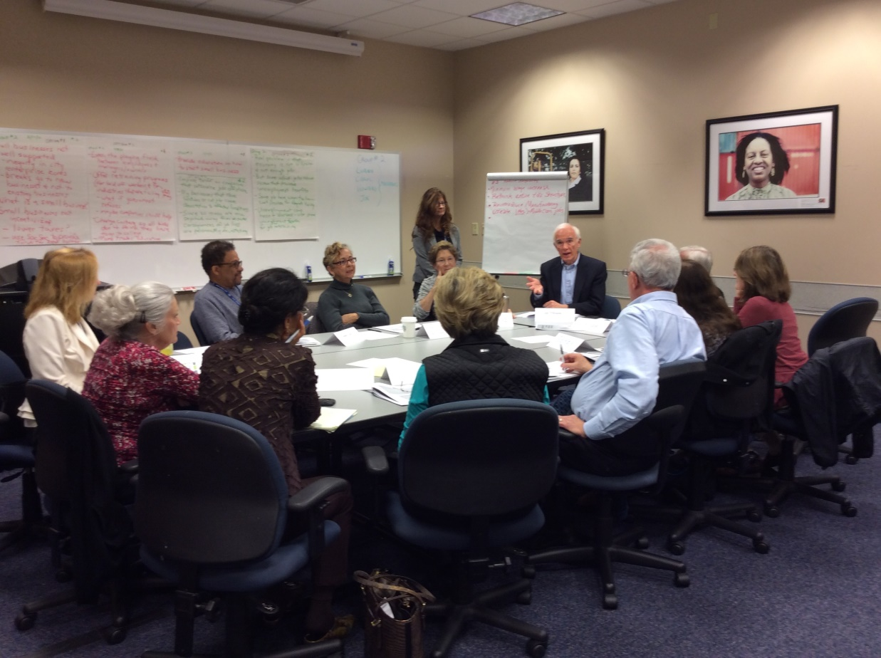
9 KEY ELEMENTS OF DELIBERATIVE FORUMS:
A SHORT COURSE IN NIF MODERATING

Slide 2
WHY DELIBERATE? Deliberation is a conversation in which people tackle controversial problems that are not easily solved and weigh different approaches with an open mind
Deliberating asks us to think about questions like these:
“What should we do?”
“How would different solutions affect the things I care most about?”
“Could there be unintended consequences I haven’t considered?”
“No solution is perfect. What trade-offs can I accept?”
Deliberation happens all the time:
We routinely deliberate about personal, family, and work decisions.
It’s essential for our politics as well

Slide 3
NIF FORUM DESIGN―4 KEY ELEMENTS These four elements can help participants deliberate:
GROUND RULES: Take a few moments to help participants understand the distinctive goal of deliberative forums and consider ground rules for the conversation
THE PERSONAL STAKE: Ask participants to talk about their personal experiences and LISTEN to those of other participants
WEIGHING OPTIONS: Ask participants to work through the options and proposals in the issue guide and wrestle with benefits and trade-offs
REFLECTIONS: Allow time for participants to reflect on their deliberations. This includes identifying POINTS OF AGREEMENT, but it’s just as important to talk about areas where participants have SECOND THOUGHTS after hearing from others. Ask participants if there are areas where they are UNDECIDED, HAVE MORE QUESTIONS, OR WANT TO DELIBERATE MORE.
Notes:
NOTE: Include a conversation about: "what is a trade-off" - to show that this is more than "pros and cons" -- but the question we use in the Writers Group is: If this action/option worked PERFECTLY, what might the downside be?

Slide 4
WHAT ARE SOME GROUND RULES TO CONSIDER?
Listen to others. Listening is as important as speaking.
Consider each approach fairly, looking at its benefits and its trade-offs
It’s okay to disagree, but do so with curiosity, not hostility. Learning more about how others think is one of the most interesting parts of a forum.
Keep an open mind. Avoid coming to conclusions until we’ve deliberated on all the options.
Others?

Slide 5
WHAT KINDS OF QUESTIONS FOSTER DELIBERATION ON THE OPTIONS?
What do you like about this option?
What worries you about it?
How might people who have other life experiences see this option?
Could this option have any unintended consequences?
Do you see any gray areas?
Others?
Notes:
Ask people to hold off on their judgments until the forum has looked at all the options
Point people to the trade-offs listed in the guide

Slide 6
WHEN SHOULD I INTERVENE?
As much as possible, participants should take responsibility for the deliberation. Moderators should intervene when:
Everyone quickly agrees with or rejects an option.
Not enough attention is being paid to the cost, trade-offs, and difficulties of an option or action.
One individual is dominating.
The time allocated for that section is used up.

Slide 7
IF I NEED TO INTERVENE . . .
Go back to the issue guide:
The guides include questions and trade-offs for each choice. Ask the group to take a look at them and talk about them.
Ask questions such as
“What would opponents (or supporters) of this option say?”
“Do you know anyone who would like (or dislike) this option? What would that person say?”

Slide 8
THE MODERATOR’S ROLE― SEVEN RESPONSIBILITIES
Explain the purpose of deliberative forums and set ground rules. Emphasize listening and reconsidering initial views
Encourage participants to talk about their personal stake—why this issue matters to them, their personal experiences with it
Insure all options are considered seriously.
If necessary, refer participants back to the issue guide to talk about tradeoffs that aren’t being considered
Keep track of time: All segments of the forum design are important
Stay neutral. Avoid being an expert.
Make sure participants reflect on what they’ve heard
Identifying points of tension and uncertainly is just as important as identifying area of agreement
Notes:
What role do you typically take in a conversation with friends? How will this experience be different for you?

Slide 9
NEED HELP CONVENING?
ENLIST A PARTNER ORGANIZATION:
Look for local organizations that bring people together on a regular basis. These include clubs, senior centers, religious groups, and book clubs
It can be a great partnership—they convene participants; you moderate the forum
CONVENING A FORUM ON YOUR OWN? TRY THE 4 x 4
One person takes responsibility for logistics: the room, refreshments, etc.
One will be the recorder.
Two will share the responsibility of moderating.
Each of the four recruits four more people & follows up to encourage them to attend

